Slide 1
SQL Queries

Slide 2
Why should one learn SQL?
Based on a survey conducted by Stack Overflow in 2020, SQL ranks as the third most commonly used programming language.
An easy mechanism to specify your data need when data is structured in the form of tables.
Most of the NoSQL technologies support SQL like language
Cassandra has CQL
Spark has SparkSQL
HIVEQL for Hadoop
InfluxQL for InfluxDB
Elasticsearch SQL
Cypher for Neo4j
SAP Hana
……

Slide 3
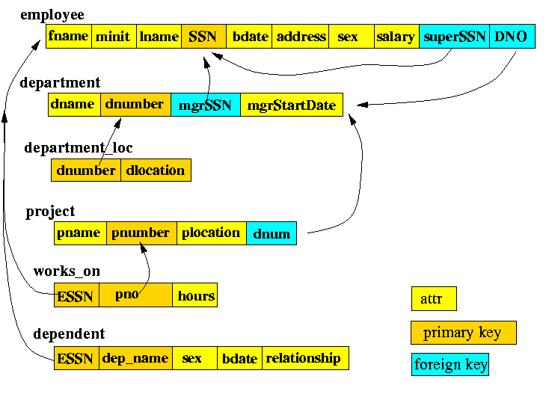
Relation Schema
Figure Credit:www.mathcs.emory.edu/~cheung/Courses/377/Syllabus/syl.html#CURRENT

Slide 4
Query Types
Based on Predicates:
Comparison of atomic values
Salary =100000, emp1.Age < emp2.Age
Comparison of an atomic value and a set of values
Salary in (Salaries of a particular group), Age >= All/Any (Age values for a particular group) …
Comparison between a pair of sets
Employees working on a specific project is subset of employees in CSE Department

Slide 5
Selection Queries
Retrieve all employee tuples for employees that work for department number 4.
Retrieve all employees earning more than Rs 30,000:
Retrieve all employees working for department number 4 and earning more than Rs 30,000:

Slide 6
Projection Queries
Retrieve only the SSN value of all the employees.
Retrieve the sex information of all the employees.
Retrieve the names of the female employees.
Retrieve the names of the employees who earn more than Rs 50,000.

Slide 7
Join R1 ⋈_{Cond} R2 = σ_{Cond} ( R1 × R2 )
Find the employees who have a higher salary than John Smith.

Slide 8
Other Join queries
Find fname and lname of all employees working in the "Research" department that earn more than Rs 50,000
Find project name for all projects worked on by Shabeg.
Find fname and lname of Ankush's supervisor.
Find fname and lname of all employees that have dependents

Slide 10
Complex Queries
Find fname and lname of all employees that do not have any dependents
Find fname and lname of all employees who work on all projects that "John Smith" works on
Find fname and lname of all employees who work on all projects controlled by the department CSE.

Slide 11
Set and group functions
Find the highest salary earned by employees in department number 5.
Find the employee(s) who earn the highest salary in the company
Find the average salary for each department.
Find the average salary for male employees and female employees.
Find the average salary of males and females for each department.
Find the average salary and number of employees for males and females for each department

Slide 12
Some more examples using set functions
Find fname and lname of all employees who work on more projects than 'John Smith'.
Find fname and lname of employees who have 2 or more dependents.
Find fname and lname of employees who have 2 or more dependents of the same sex.
Find fname and lname of the employees who have the most number of dependents.
Find fname and lname of the employee(s) in the Research department who earn the highest salary in the Research department.
For each department, list the department name and the highest salary paid to an employee in that department

